Slide 1
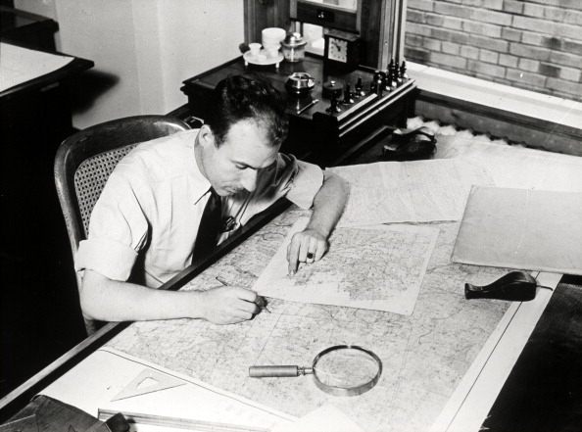
MAP ATTACK SKILLS
MR GAGNON 6TH GRADE SOCIAL STUDIES 2016-2017

Slide 2
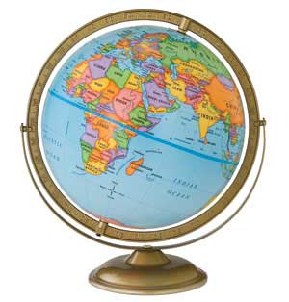
Globe
A model of the earth

Slide 3
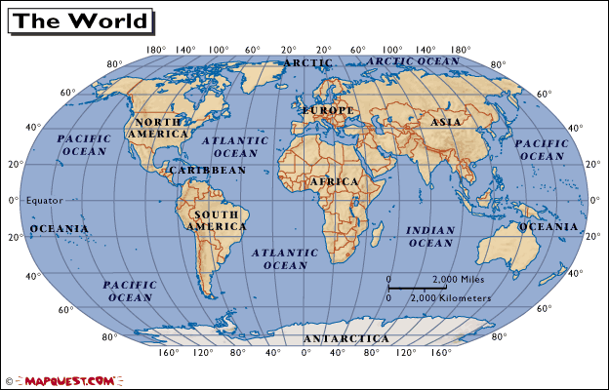
Map
A flattened out view of the world

Slide 4



Symbols
Symbols are pictures that represent something.

Slide 5
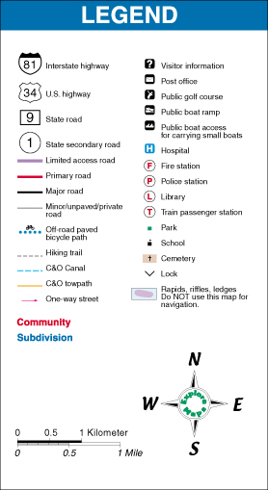
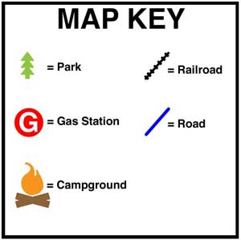
Key or legend
A key or legend is an area on the map that shows us what each symbol represents.

Slide 6
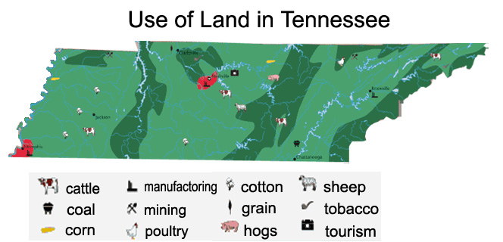
Can you understand this legend?

Slide 7
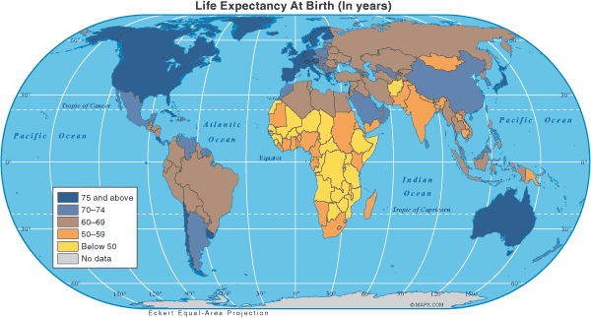
Age Expectancy
Legend

Slide 8
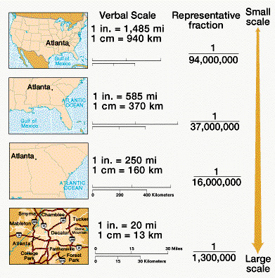
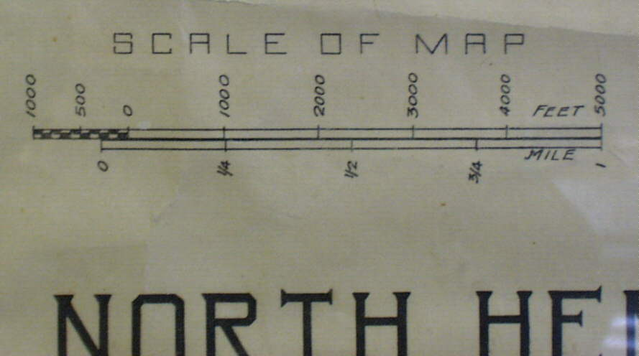
Scale
Scale is the section of the map that shows how much smaller the map is compared to the real area it represents and its distance from other places.

Slide 9
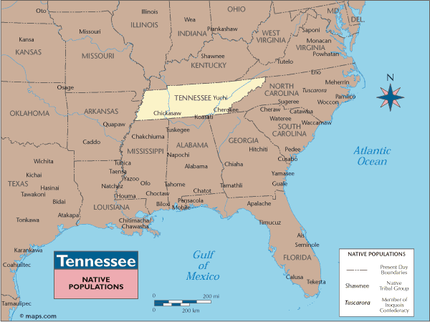
Scale

Slide 10
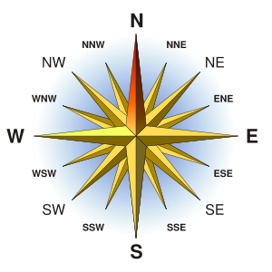
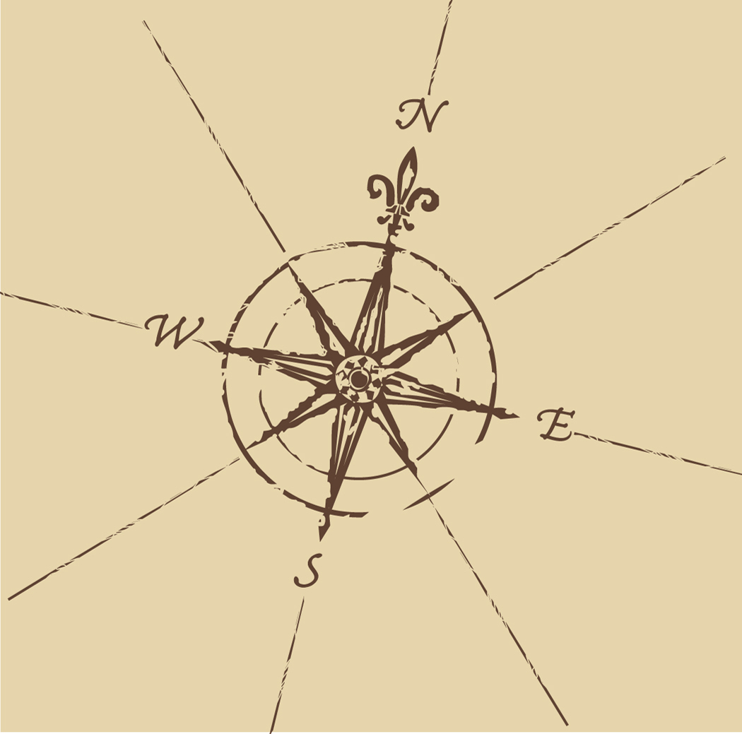
Compass Rose
A compass rose is a symbol on a map which indicates the directions for a map.

Slide 11
Cardinal Directions
North
South
East
West

Slide 12
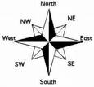
Intermediate directions
Northeast
Southeast
Northwest
Southwest

Slide 13
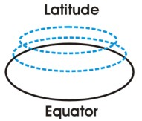
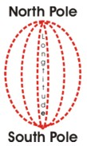
Latitude and Longitude
The earth is divided into lots of lines called latitude and longitude.

Slide 14

Where is 0 degree?
P
R
I
M
E
M
E
R
I
D
I
A
N
The prime meridian is 0 degrees longitude. This imaginary line runs through the United Kingdom, France, Spain, western Africa, and Antarctica.

Slide 15

Where is 0 degree?
The equator is 0 degree latitude.
It is an imaginary belt that runs halfway point between the North Pole and the South Pole.
Equator

Slide 16
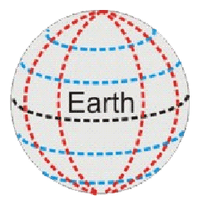
Lines
Longitude lines run north and south.
Latitude lines run east and west.
The lines measure distances in degrees.
Latitude
Longitude

Slide 18
Hemispheres
By using the equator and prime meridian, we can divide the world into four hemispheres, north, south, east, and west.

Slide 19
